Slide 1

Cell Phone Price Prediction and Analysis
Atanu Basak

Slide 2
Cell Phone are one of the most widely used gadgets in recent years, every year there are
some new feature upgrades are happening, and price increases accordingly. I am building a
predictive model, that can predict the price category of cell phones depending on its
features. In this problem the phone prices are divided into 4 categories ‘low cost’, ‘medium
cost’, ‘high cost’ and ‘very high cost’. If the model works perfectly with good accuracy, it
can be used for cell phone price predictions.
Business Problem

Slide 3
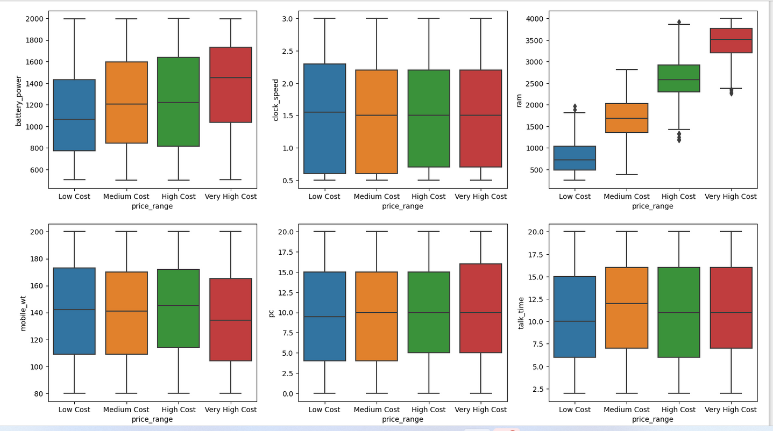
Looking at the above bar plots it clearly says the two features battery power and ram have major influence on cell phone prices. The higher battery power cell phones are more costly compared to lower battery power. Similar pattern is there for ram, the speed of the mobile is very much dependent on ram, higher ram has high cell phone prices and mobile having lower size rams are low in price.
Categorical analysis

Slide 4
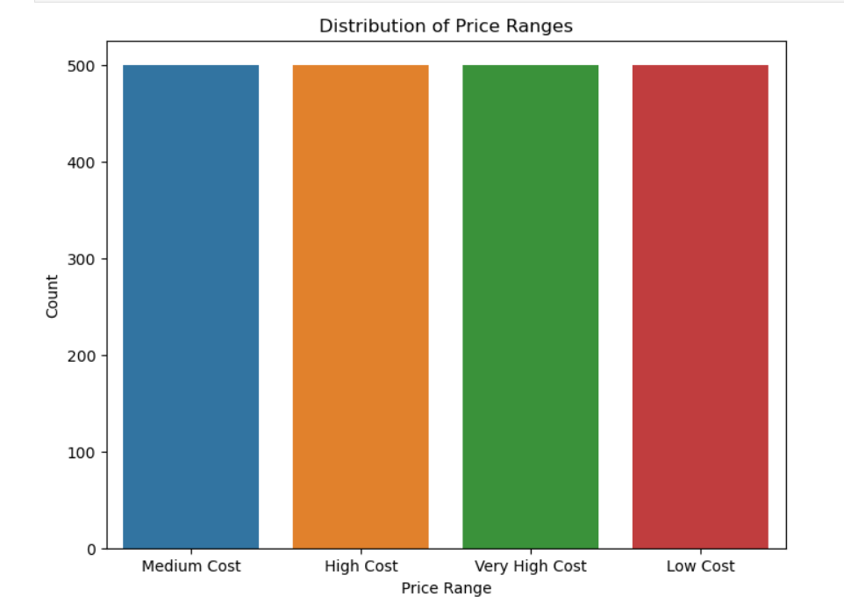
here are four price categories and data has been created by taking uniform samples from each category, so we can say the prices in the sample of cell phone data are uniformly distributed as shown in the below diagram.
Sampling analysis on Price category

Slide 5
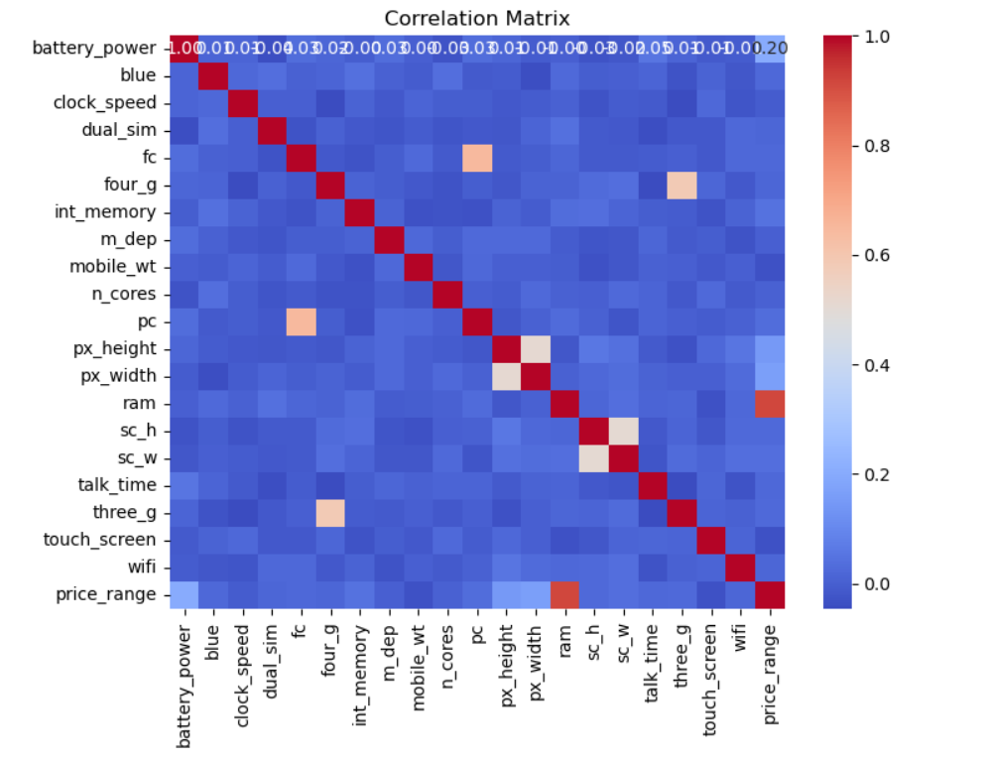
Here is the correlation matrix diagram on the cell phone data. The diagram also shows that ram has a high correlation with cell phone prices, i.e. the higher the ram the prices are higher for cell phones.
Correlation

Slide 6
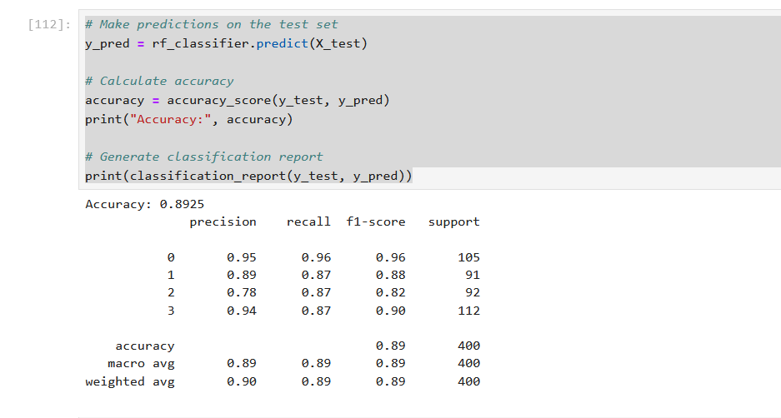
I have divided the data into 80-20 between training and test and fit Random Forest Classifier model on the data, The accuracy came as 89% for the fitting.
Random forest model

Slide 7
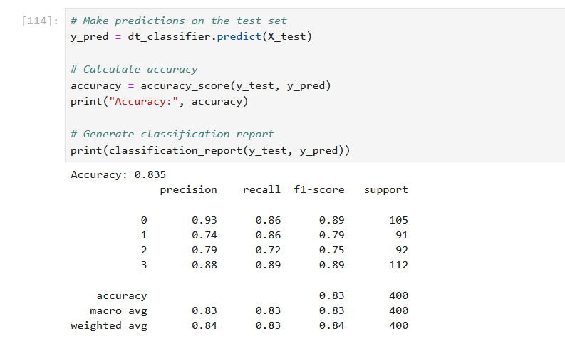
On the same training data, I also fit Decision Tree Classifier model and check its accuracy on the test data, The accuracy came as 83% for the fitting.
Decision tree model

Slide 8
While implementation the prediction as an API, we must be careful on several thing, as user will input about the mobile information and different feature related information will be available on the server for all the user's personal mobile. So, the data must be purged in a timely manner. We must be careful not to collect user personal information tagged with the mobile as the scope of the application is only limited to cell phone price prediction.
Ethical assessment

